Slide 1

School of Computing Science and Engineering
School of Computing Science and Engineering
Program Name: BTech , 5 SEM
Course Code : E2UC502T
Course Name : Software Testing & Quality Assurance
Software Quality Assurance and Standards

Slide 2
School of Computing Science and Engineering
“Software Quality Assurance & Standards"
Outline
Basic software quality parameters and its metrics
Quality management models: ISO, CMM
Software Configuration Change and types of errors

Slide 3
School of Computing Science and Engineering
“Software Quality Assurance & Standards"
What is Quality?
Quality is defined as the product or services that should be "fit for use and purpose.“
Quality is all about meeting the needs and expectations of customers concerning functionality, design, reliability, durability, and price of the product.
Quality is defined as the features or the attributes of the products that are appreciated by the end-users or the customers. “Quality means conformance to requirements “ as indicated by Crosby in 1979.

Slide 4
School of Computing Science and Engineering
“Software Quality Assurance & Standards"
What is Assurance?
Assurance is a positive declaration on a product or service.
It is all about the product which should work well.
It provides a guarantee which would work without any problem according to expectations and requirements.

Slide 5
School of Computing Science and Engineering
“Software Quality Assurance & Standards"
What is Quality Assurance?
Quality Assurance is also known as QA Testing. QA is defined as an activity to ensure that an organization is providing the best product or services to the customers.
Software Quality Assurance seems it is all about evaluation of software based on functionality, performance, and adaptability; however software quality assurance goes beyond the quality of the software, it also includes the quality of the process used to develop, test and release the software.
Software Quality assurance is all about the Software Development lifecycle that includes requirements management, software design, coding, testing, and release management.
Quality Assurance is the set of activities that defines the procedures and standards to develop the product.

Slide 6
School of Computing Science and Engineering
“Software Quality Assurance & Standards"
What is Quality Assurance?
Quality assurance is an orderly procedure of inspecting a particular product or a service that is being developed to meet the required standards. Many organizations allocate a whole unit for quality assurance purposes.
A good quality assurance system not just enhances the organization’s credibility, it also builds customer’s belief, thereby improving the process which helps the organization to compete with others.
During World War II, military weapons were checked and tested for defects after they were developed. However, in today’s scenario quality assurance systems emphasize on identifying the defects before the development of the final product.

Slide 7
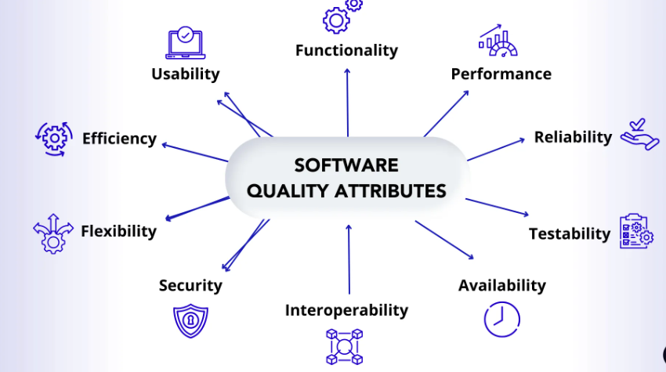
School of Computing Science and Engineering
“Software Quality Assurance & Standards"
Software Quality Attributes
Figure : Software Quality Attributes

Slide 8
School of Computing Science and Engineering
“Software Quality Assurance & Standards"
WHAT ARE SOFTWARE QUALITY ASSURANCE COMPONENTS?
Pre-project Plan ensures that the resources required for project, schedule, and budget should be clearly defined. Plan for development and ensuring quality has been determined.
The following are the components:
Plan for growth
Schedules for high-quality plans
Resources required (Hardware & Human resources)
Risk assessments
Methodology for the project

Slide 9
School of Computing Science and Engineering
“Software Quality Assurance & Standards"
What are Software Quality Assurance Components?
Project lifecycle components: A project lifecycle is usually comprised of two stages.
The first one is the development stage and then comes the operation-maintenance stage.
In the development stage, SQA components help to identify the design and programming errors.
The SQA components for the operation-maintenance stage include the development lifecycle components along with specialized maintenance components aimed to improve the maintenance tasks.
The project lifecycle components include:
Reviews
Expert opinions
Software testing
Software maintenance
Sub-contractors quality assurance

Slide 10
School of Computing Science and Engineering
“Software Quality Assurance & Standards"
Infrastructure error prevention and improvement components
The main goal of these components is the prevention of software faults and minimizes the rate of errors.
These components include:
Procedure & work instructions
Templates & checklists
Staff training, retaining & certification
Preventive & corrective actions
Configuration management
Documentation control

Slide 11
School of Computing Science and Engineering
“Software Quality Assurance & Standards"
Software Quality Management Components
This class of components consists of controlling the development and maintenance activities. These components establish the managerial control of software development projects. The management control aims to prevent the project from going over budget and behind schedule.
The management control components include:
Project progress control
Software quality metrics
Software quality costs

Slide 12
School of Computing Science and Engineering
“Software Quality Assurance & Standards"
Standardization, Certification, and SQA assessment components
The components aim to implement international managerial and professional standards within the organization. These components help to improve the coordination among the organizational quality systems and establish standards for the project process.
The components include:
Quality management standards
Project process standards

Slide 13
School of Computing Science and Engineering
“Software Quality Assurance & Standards"
Organizing for SQA – the human components
The main aim of this class of components is to initiate and support the implementation of SQA components, identify any deviations from the predefined SQA procedures & methods and recommend improvements.
The SQA organizational team includes test managers, testers, SQA unit, SQA committee, and SQA forum members.

Slide 14

School of Computing Science and Engineering
“Software Quality Assurance & Standards"
Evolution of Quality Management System
Quality Systems are basically evolved over the past some years.
The main task of quality control is to detect defective devices and it also helps in finding the cause that leads to the defect. It also helps in the correction of bugs.
Quality Assurance helps an organization in making good quality products. It also helps in improving the quality of the product by passing the products through security checks.
Total Quality Management (TQM) checks and assures that all the procedures must be continuously improved regularly through process measurements.

Slide 15
School of Computing Science and Engineering
“Software Quality Assurance & Standards"
Software Quality Management System:
Software Quality Management System contains the methods that are used by the authorities to develop products having the desired quality.
Managerial Structure: Quality System is responsible for managing the structure as a whole. Every Organization has a managerial structure.
Individual Responsibilities: Each individual present in the organization must have some responsibilities that should be reviewed by the top management and each individual present in the system must take this seriously.
Quality System Activities: The activities which each quality system must have been
Project Auditing
Review of the quality system
It helps in the development of methods and guidelines.
Production of documents for the top management summarizing the effectiveness of the quality system in the organization.

Slide 16
School of Computing Science and Engineering
“Software Quality Assurance & Standards"
ISO 9000 Certification
ISO (International Standards Organization) is a group or consortium of 63 countries established to plan and fosters standardization. ISO declared its 9000 series of standards in 1987. It serves as a reference for the contract between independent parties.
The ISO 9000 standard determines the guidelines for maintaining a quality system. The ISO standard mainly addresses operational methods and organizational methods such as responsibilities, reporting, etc. ISO 9000 defines a set of guidelines for the production process and is not directly concerned about the product itself.
The ISO 9000 series of standards is based on the assumption that if a proper stage is followed for production, then good quality products are bound to follow automatically.

Slide 17
School of Computing Science and Engineering
“Software Quality Assurance & Standards"
ISO 9000 Certification
The types of industries to which the various ISO standards apply are as follows.
ISO 9001: This standard applies to the organizations engaged in design, development, production, and servicing of goods. This is the standard that applies to most software development organizations.
ISO 9002: This standard applies to those organizations which do not design products but are only involved in the production. Examples of these category industries contain steel and car manufacturing industries that buy the product and plants designs from external sources and are engaged in only manufacturing those products. Therefore, ISO 9002 does not apply to software development organizations.
ISO 9003: This standard applies to organizations that are involved only in the installation and testing of the products. For example, Gas companies.

Slide 18
School of Computing Science and Engineering
“Software Quality Assurance & Standards"
How to get ISO 9000 Certification?
An organization determines to obtain ISO 9000 certification applies to ISO registrar office for registration. The process consists of the following stages:
1. Application: Once an organization decided to go for ISO certification, it applies to the registrar for registration.
2. Pre-Assessment: During this stage, the registrar makes a rough assessment of the organization.
3. Document review and Adequacy of Audit: During this stage, the registrar reviews the document submitted by the organization and suggest an improvement.

Slide 19
School of Computing Science and Engineering
“Software Quality Assurance & Standards"
How to get ISO 9000 Certification?
4. Compliance Audit: During this stage, the registrar checks whether the organization has compiled the suggestion made by it during the review or not.
5. Registration: The Registrar awards the ISO certification after the successful completion of all the phases.
6. Continued Inspection: The registrar continued to monitor the organization time by time.

Slide 20
School of Computing Science and Engineering
“Software Quality Assurance & Standards"
CAPABILITY MATURITY MODEL (CMM):
Capability Maturity Model (CMM) was developed by the Software Engineering Institute (SEI) at Carnegie Mellon University in 1987.
It is a framework that is used to analyze the approach and techniques followed by any organization to develop software products.
It also provides guidelines to further enhance the maturity of the process used to develop those software products.
It is based on profound feedback and development practices adopted by the most successful organizations worldwide.
This model describes a strategy for software process improvement that should be followed by moving through 5 different levels.
Each level of maturity shows a process capability level. All the levels except level 1 are further described by Key Process Areas (KPA).

Slide 21
School of Computing Science and Engineering
“Software Quality Assurance & Standards"
Capability Maturity Model (CMM):
The Capability Maturity Model (CMM) is a procedure used to develop and refine an organization's software development process.
The model defines a five-level evolutionary stage of increasingly organized and consistently more mature processes.
CMM was developed and is promoted by the Software Engineering Institute (SEI), a research and development center promote by the U.S. Department of Defense (DOD).
Capability Maturity Model is used as a benchmark to measure the maturity of an organization's software process.
Capability Maturity Model (CMM) is a methodology used to develop, refine maturity of an organizations software development process. It is developed by SIE in mid 1980. It is a process improvement approach.

Slide 22
School of Computing Science and Engineering
“Software Quality Assurance & Standards"
Capability Maturity Model (CMM):
To assess an organization against a scale of 5 process maturity levels. It Deals with the what processes should be implemented & not so much with the how processes should be implemented. Each maturity level comprises a predefined set of process areas called KPA (Key Process Area), these KDA – Goals, Commitment, Ability, measurement, verification.

Slide 23
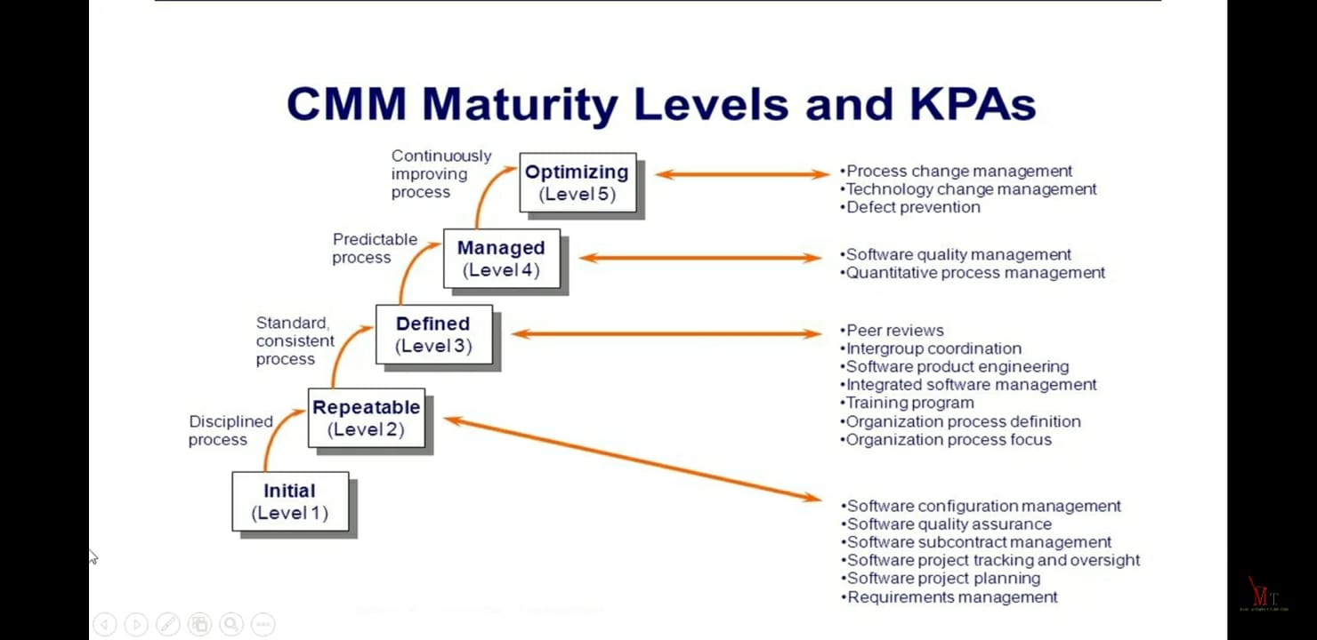
School of Computing Science and Engineering
“Software Quality Assurance & Standards"
Capability Maturity Model (CMM):

Slide 24
School of Computing Science and Engineering
“Software Quality Assurance & Standards"
Levels of Capability Maturity Model (CMM)
Levels of Capability Maturity Model (CMM) are as following below.
1.Level One: Initial – Work is performed informally. A software development organization at this level is characterized by AD HOC activities(organization is not planned in advance.).
2. Level Two : Repeatable – Work is planned and tracked.
This level of software development organization has a basic and consistent project management processes to TRACK COST, SCHEDULE, AND FUNCTIONALITY.
The process is in place to repeat the earlier successes on projects with similar applications.

Slide 25
School of Computing Science and Engineering
“Software Quality Assurance & Standards"
Levels of Capability Maturity Model (CMM)
3. Level Three : Defined – Work is well defined. At this level the software process for both management and engineering activities are DEFINED AND DOCUMENTED.
4. Level Four : Managed – Work is quantitatively controlled.
Software Quality management – Management can effectively control the software development effort using precise measurements. At this level, organization set a quantitative quality goal for both software process and software maintenance.
Quantitative Process Management – At this maturity level, The performance of processes is controlled using statistical and other quantitative techniques, and is quantitatively predictable.

Slide 26
School of Computing Science and Engineering
“Software Quality Assurance & Standards"
Levels of Capability Maturity Model (CMM)
5. Level Five : Optimizing – Work is Based Upon Continuous Improvement. The key characteristic of this level is focusing on CONTINUOUSLY IMPROVING PROCESS performance.
Key features are:
Process change management
Technology change management
Defect prevention

Slide 27
School of Computing Science and Engineering
“Software Quality Assurance & Standards"
Types of Errors in Software Testing
1. User Interface Error
Interface error is the state or condition when the app cannot do what the user wants.
2. Error Handling Errors
Error handling errors occur when the software does not handle exceptions or unexpected situations correctly, resulting in crashes or incorrect behavior.
Example: During a special sale event, an e-commerce website encounters a sudden surge in traffic, overwhelming the server and leading to an unexpected error. Still, instead of gracefully handling the error and displaying a user-friendly message, it crashes and displays a generic error page, causing frustration and confusion for the customers.

Slide 28
School of Computing Science and Engineering
“Software Quality Assurance & Standards"
Types of Errors in Software Testing
3. Boundary Related Errors
Boundary condition errors occur when the software behaves unexpectedly or improperly when input values are at the extreme ends of valid ranges or beyond the specified limits.
Example: A scientific simulation software requires users to input specific parameters, such as temperature values, to perform accurate calculations. If the software does not handle boundary conditions correctly, it may crash or produce incorrect results when users input values outside the acceptable temperature range, causing inaccurate scientific predictions.

Slide 29
School of Computing Science and Engineering
“Software Quality Assurance & Standards"
Types of Errors in Software Testing
4. Control Flow Errors
Control flow errors occur when the order or flow of execution in the software does not follow the intended logic, leading to unexpected behavior or incorrect outcomes. These errors can arise from false conditional statements, loop constructs, or function calls.
Example: A control flow error in an online food ordering application can lead to improper order handling. If the app’s logic for checking the availability of a specific menu item is flawed, it may allow customers to order items that are temporarily out of stock. Consequently, the restaurant might be unable to fulfill these orders, leading to customer dissatisfaction and potentially damaging the business’s reputation.

Slide 30
School of Computing Science and Engineering
“Software Quality Assurance & Standards"
Types of Errors in Software Testing
5.Calculation Errors
It is a type of error where the software returns with incorrect values and usually happens because of wrong logic, incorrect formula, data type mismatch, function call issues, etc.
This type of error can cause a lot of problems for businesses. For example - in the banking industry if calculation errors take place then it might lead to a loss of capital from the customer’s bank account.
6. Documentation Errors
Documentation errors occur when the software’s documentation, such as user manuals or API references, contains inaccuracies, outdated information, or missing details, leading to confusion for developers or end-users.
Example: A software library provides API documentation that contains outdated method signatures and incorrect usage examples. Developers trying to integrate the library struggle to make it work due to the discrepancies between the documentation and the actual library implementation.

Slide 31
School of Computing Science and Engineering
“Software Quality Assurance & Standards"
Types of Errors in Software Testing
7. Usability and UX Errors
Usability and user experience errors arise when the software’s interface is confusing, difficult to navigate, or lacks intuitiveness, leading to user dissatisfaction and potential product abandonment.
Example: A mobile banking app has a cluttered and confusing user interface with multiple nested menus and buttons. Users find it challenging to perform basic transactions and often give up using the app, leading to customer loss for the bank.
Performance Errors
Performance errors occur when the software performs poorly under specific conditions, such as high load or extensive data processing, leading to slow response times or crashes.
Example: A popular online streaming platform experiences frequent buffering and playback issues during peak hours when many users access the service simultaneously. This performance error negatively impacts the user experience and leads to user dissatisfaction.

Slide 32
School of Computing Science and Engineering
“Software Quality Assurance & Standards"
Calculation Errors
Functional Errors
This bug affects the functionality of an application or the way software behaves. These types of bugs are detected during the functional testing of an application.
An example of this type of bug in software testing is - the login button not allowing one to log in to certain software, the save button doesn’t save a file, and many more.

